Slide 1
Pointers & Dynamic Memory Allocation
Unit-02

Slide 2
Address Operator
Unit-02.1

Slide 3
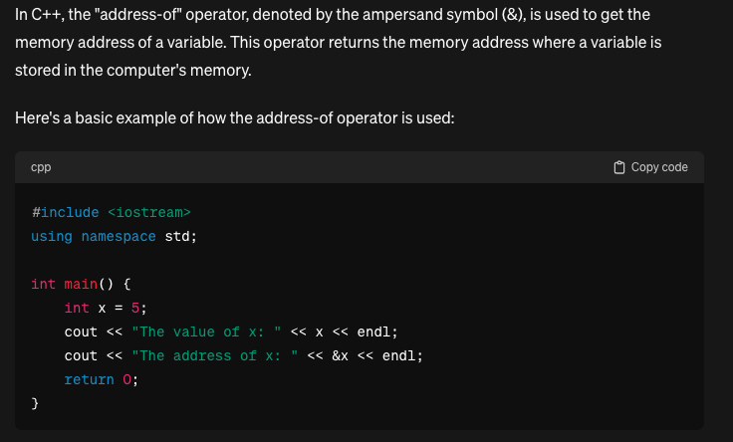
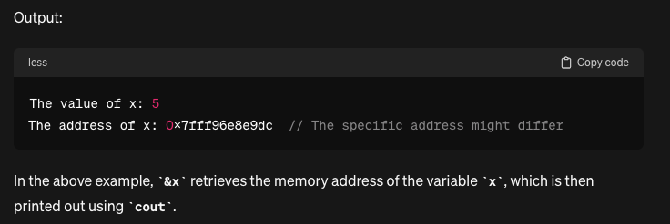

Slide 4
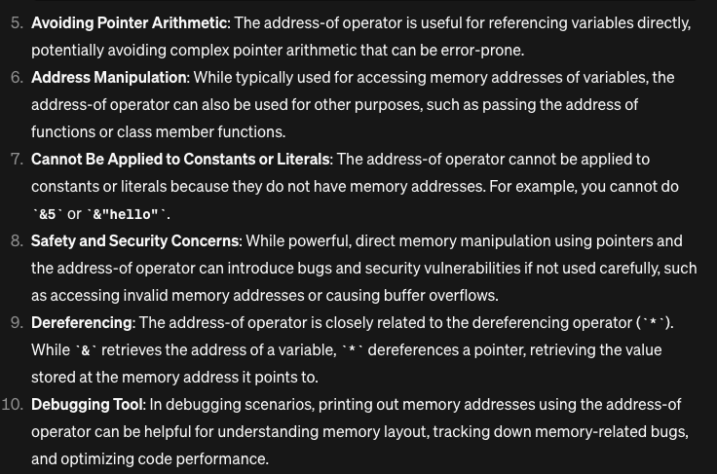
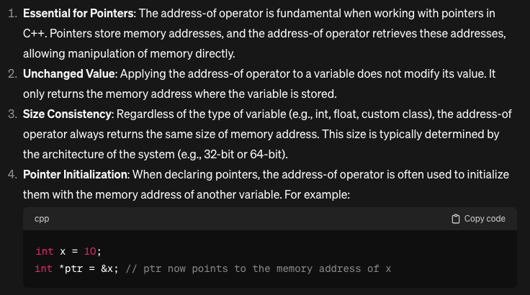
Things you should know…

Slide 5
Pointer Operator
Unit-02.2

Slide 6
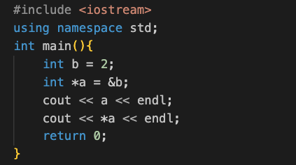

Let’s Compare These Two Blocks of Codes

Slide 7
What is different here?
Well, this is how you define. Both ways are right.
What is happening here?
int* is a type here, we call it an integer-pointer
We see that the value of ‘a’ holds the ‘address of b’ which is ‘&b’
Recommendation: Use int* a = &b; instead of using int *a = &b; Here semantics can be helpful, e.g., the first one you can read ‘a’ as int* type, while the later one most of the beginners get confused and read it as ‘*a’ as int

Slide 8
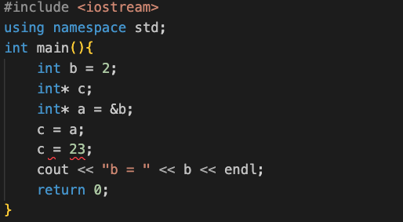
Do you know why this will fail?

Slide 9
* as dereference Operator
Unit-02.3

Slide 10
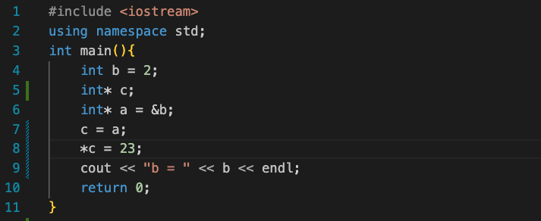
What do you think will be the output of line 9?

Slide 11
Something is happening in line-8
So why? *c = 23, why not c = 23; We now know the answer. *c resolves the address to value, the value resolved is int, so you can basically use int i.e., 23 to replace whatever pointer ‘c’ points to

Slide 12
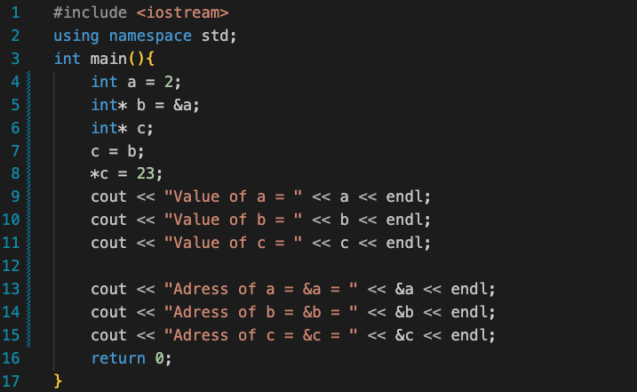

What do you think will be the last value of ‘a’ will be?

Slide 13
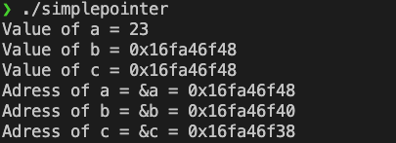
Lets inspect in more detail

Slide 14
Lets inspect in more detail
0x16fa46f40
0x16fa46f48
@line 5
address
0x16fa46f48
b [int*]
VALUE
@line 4
2
0x16fa46f38
0x16fa46f38
variable
a [int]
xxxxxxxxxxx
@line 6
0x16fa46f48
@line 7
c [int*]
c [int*]
0x16fa46f48
@line 8
23
a [int]

Slide 15
Thought!!! Pointers as natural choice for array?
Unit-02.4

Slide 16
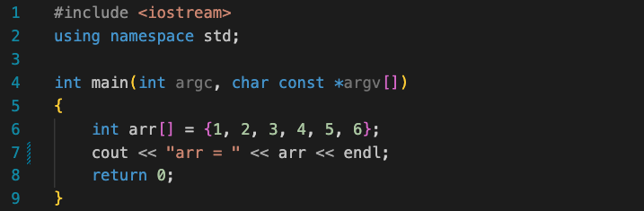

Case study..
If you were thinking this would print an entire array, it’s time to review some basics….
Here, ‘arr’ seems some kind of address. Well if you are guessing if this is the address of the beginning of the array,
then you are right.

Slide 17
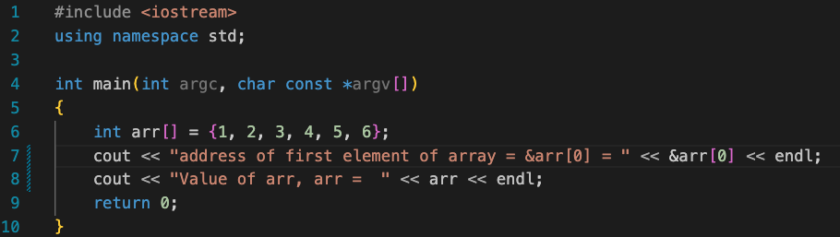
Case study..
If you were thinking this would print an entire array, it’s time to review some basics….
Here, ‘arr’ seems some kind of address. Well if you are guessing if this is the address of the beginning of the array,
then you are right.

Slide 18
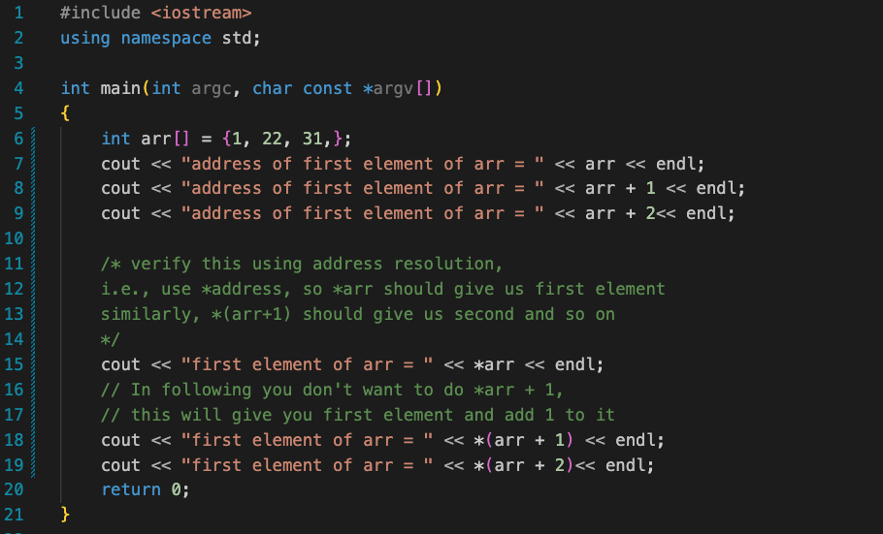
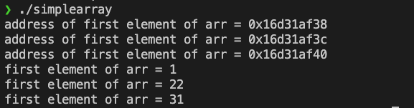
likewise..

Slide 19
What is the key take away here? int arr[]; // here arr holds address of first element of arr int* k; // here k holds address of some int So you can treat array as a pointer.

Slide 20
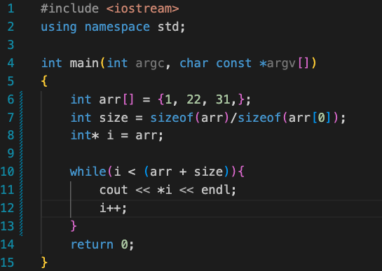

so, this is possible. (traversing array using while loop instead of for loop)

Slide 21
Dynamic Memory Allocation with examples
Unit-02.5

Slide 22
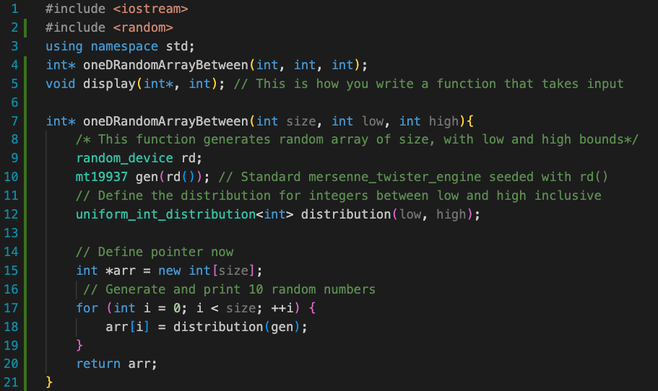
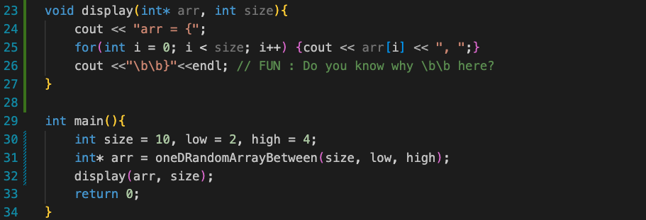
One-D array example Illustrating Dynamic Memory Allocation
Dynamic memory allocation in C++ refers to the process of allocating memory at runtime from the heap (rather than the stack) for storing data. It allows for the creation and manipulation of data structures whose size is not known at compile time. This is typically achieved using the new keyword to allocate memory and the delete keyword to deallocate it when it's no longer needed. Dynamic memory allocation provides flexibility but also requires careful management to avoid memory leaks or undefined behavior.
Dynamic Memory Allocation

Slide 23
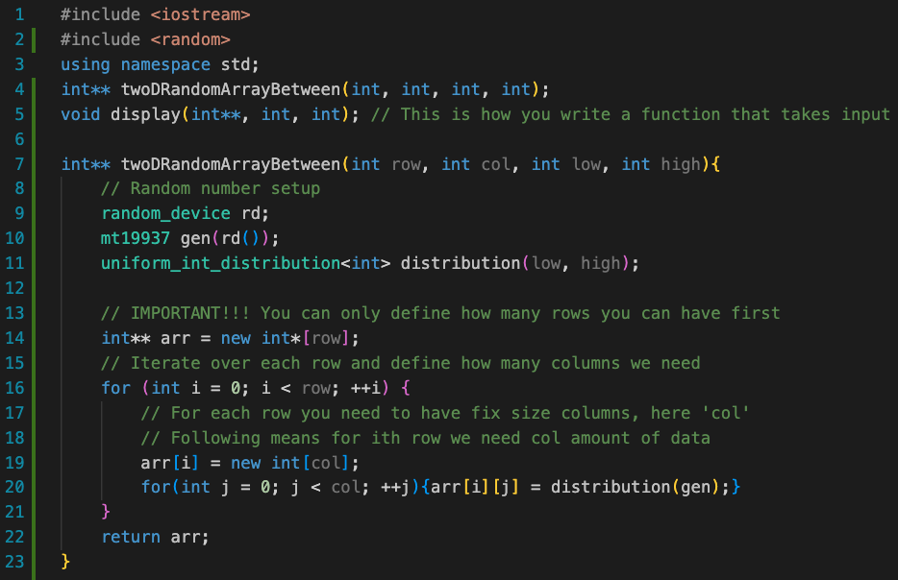
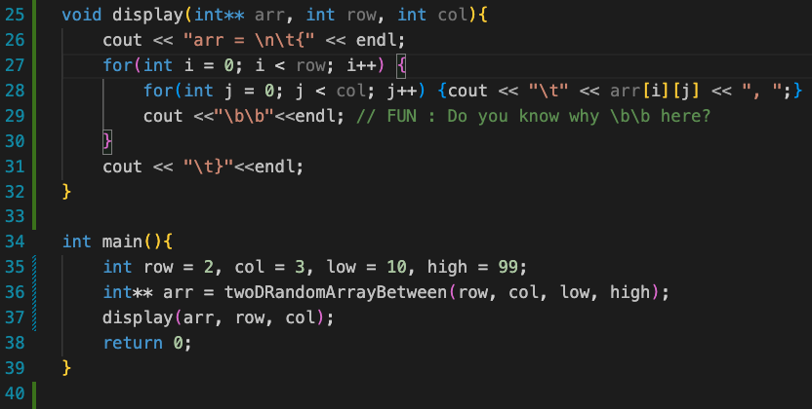
Two-D array example Illustrating Dynamic Memory Allocation | Generate 2x3 random array with low, high
Two Steps of Dyn.Mem.All
- First allocate number of rows
- Second allocate number of columns
What do you think we should do for 3D array?
Example – IMAGE
IMAGE in CG is represented as C x H x W, where,
C is number of color channels, RGB, which is 3
H is number of pixels in rows, or width of image
W is number of pixels in cols, or height of image
Dynamic Memory Allocation
Dynamic Memory Allocation

Slide 24
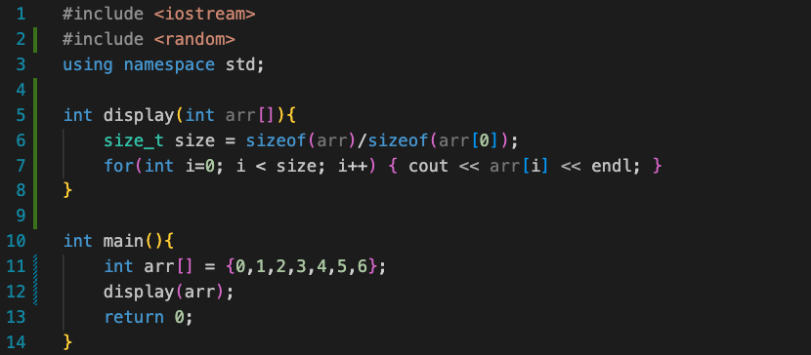
Test Your knowledge. Find out why following is a stupid idea..

Slide 25
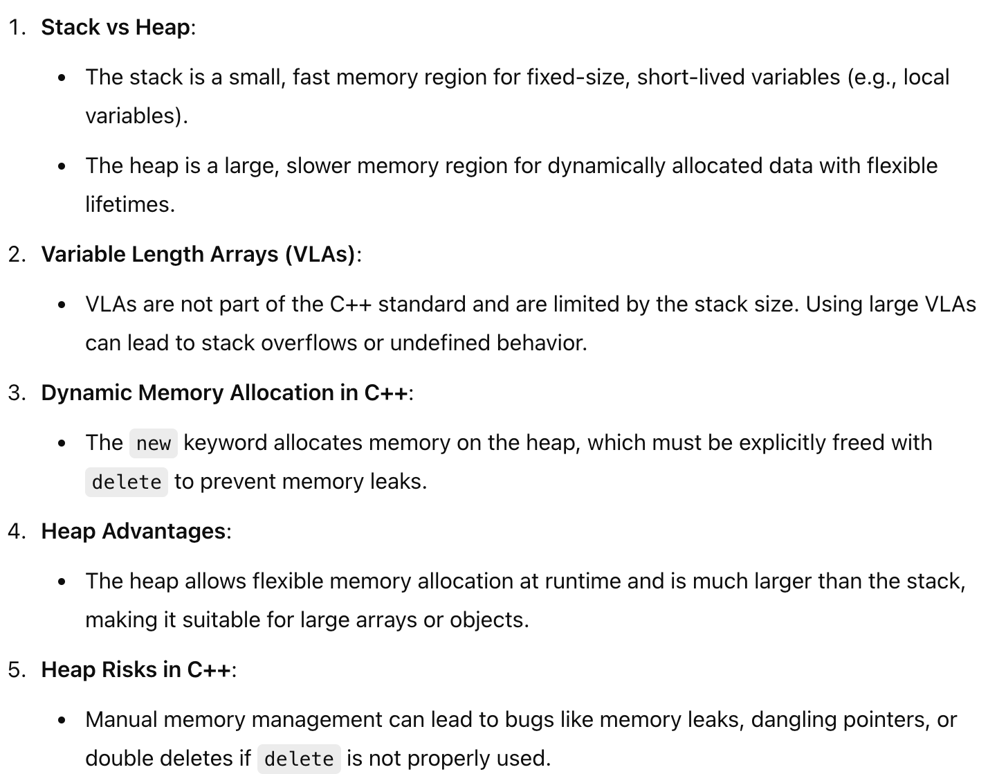
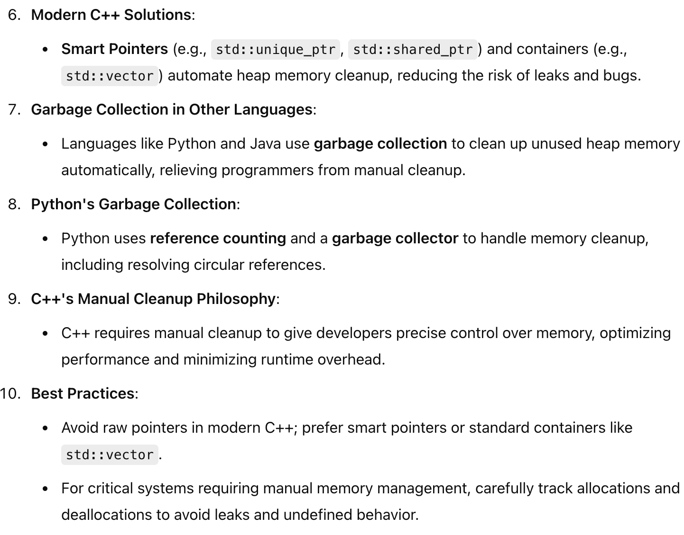
FYI

